Slide 1

PCR in Python
Justin Hare
Tyler Lucas
Alex Karwowski

Slide 2
The Basics of PCR
Denaturation – Split the DNA into 2 separate strands.
Annealing – Attached Generated Primers to each strand.
Elongation – Use the TAQ Polymerase to extend the primers by adding complementary nucleotides

Slide 3
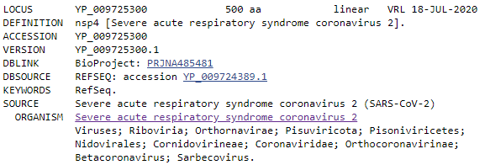
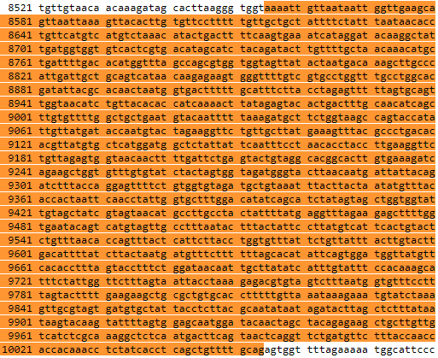
Getting Our Genome
Our Genome is nsp4.
It is roughly 1500 nucleotides long.
One of several proteins found in SARS-CoV-19.

Slide 4
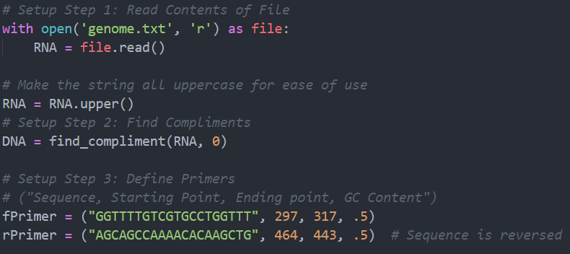
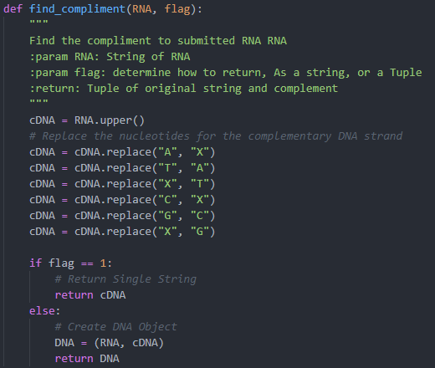
Setup in Python
3 Setup Steps:
Get our Genome into a readable format.
Find the Compliment of our Genome
Get our Primers.

Slide 5
Denaturation
Separating the DNA by raising the temperature.

Slide 6
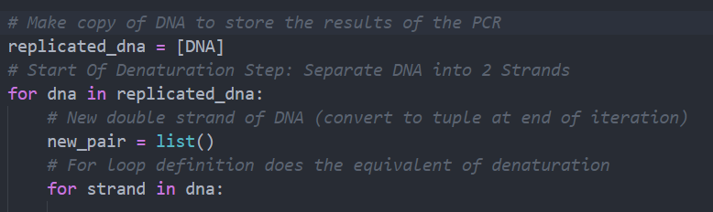
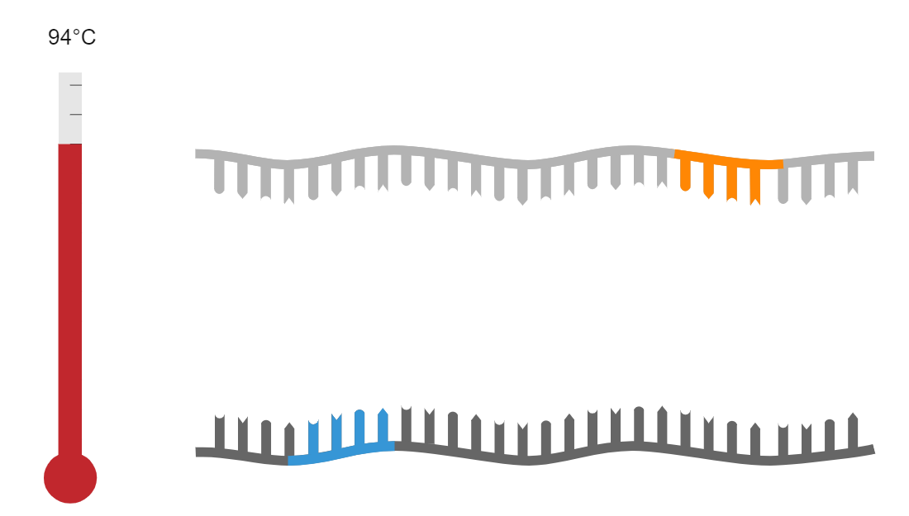
Denaturation in Python
We took a list that stores completed strands of DNA and split each DNA entry into 2 strands.

Slide 7
Annealing
The temperature is lowered to allow single- stranded primers to attach to each of the separated strands.

Slide 8
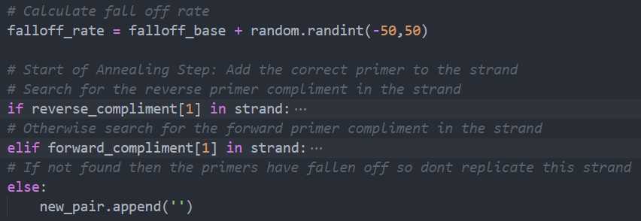
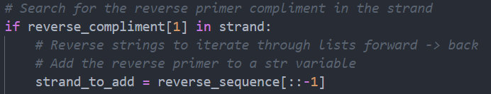
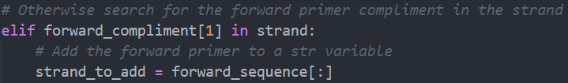
Annealing in Python
First, we define the falloff rate for a strand.
Then we search the strand for the compliment of either primer.
If neither primer is found add an empty string to the list cause the primers have fallen off

Slide 9
Elongation
The temperature is raised to allow TAQ Polymerase to bind to the primers.
Then the TAQ Polymerase build a strand of complimentary DNA to each strand

Slide 10
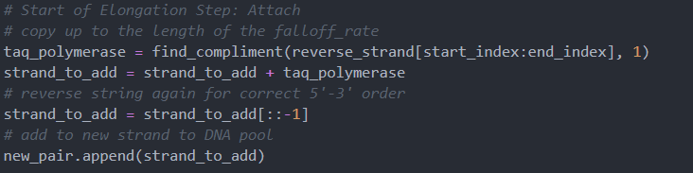
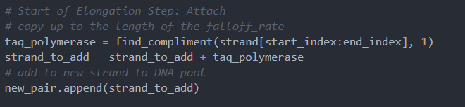
Elongation in Python
We use our taq_polymerase to find the compliment of the strand up until the falloff rate.
We add this strand to our string variable and add it to a list of other strands.

Slide 11
The Cycle Repeats
The cycle repeats copying strands, adjusting falloff rates, and creating up to 2^20 segments of DNA through this process.

Slide 12
Methods

Slide 13
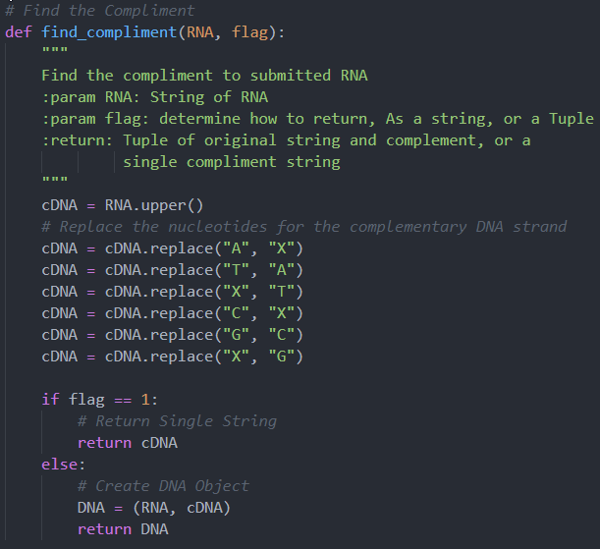
METHOD: find_compliment()
Parameters: RNA and flag
Finds the compliment to a string and returns either a single string or a Tuple of strings

Slide 14
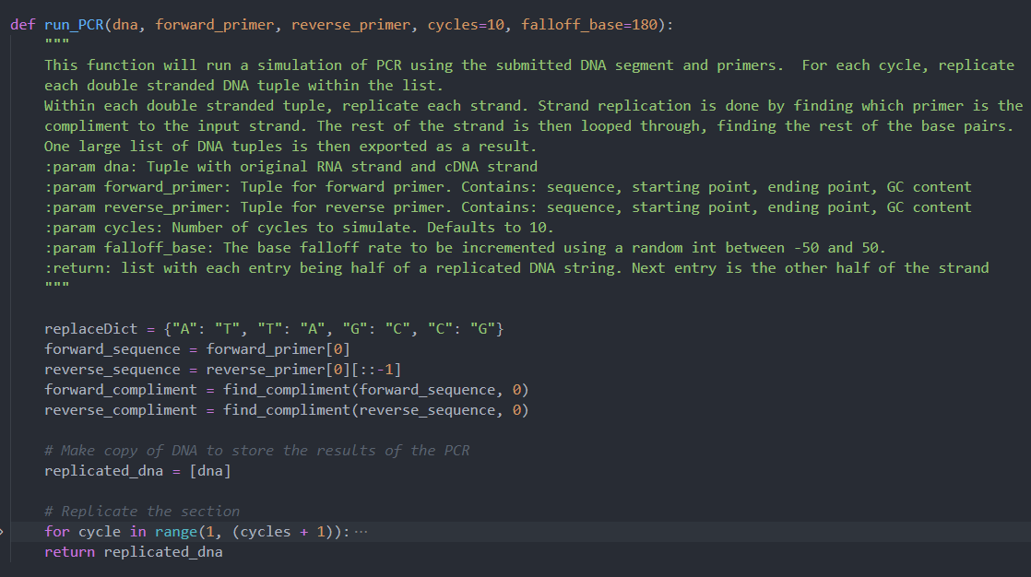
Method: run_PCR()
Parameters: dna, forward_ primer, reverse_primer, cycles, falloff_base.
Runs the actual PCR process and returns the list of DNA replicated.

Slide 15
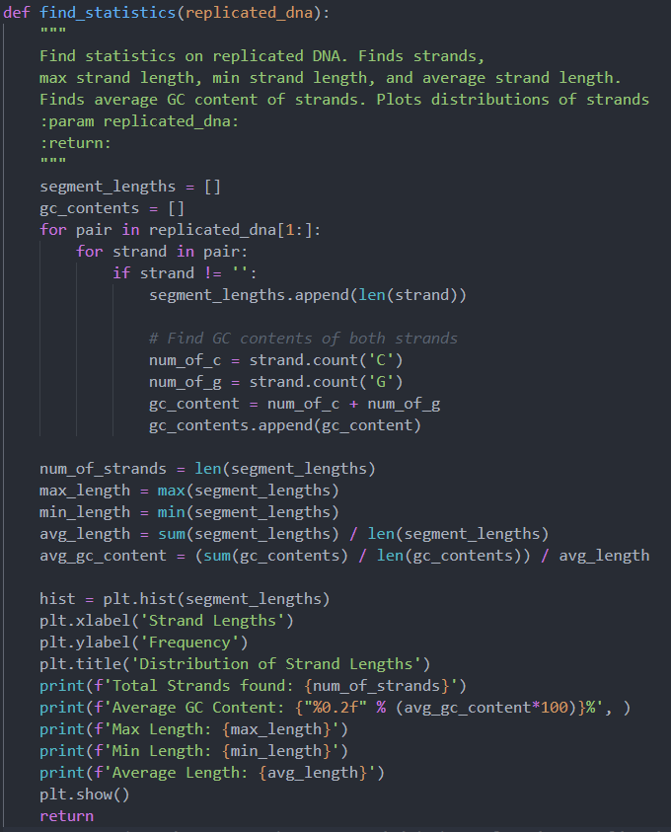
Method: find_statistics()
Parameters: replicated_dna
Calculates all the data from the DNA strands that we replicated in the PCR function.

Slide 16
RESULTS

Slide 17
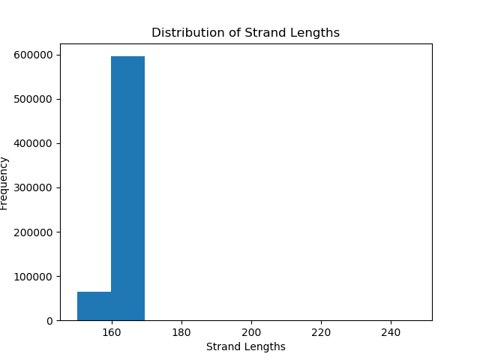
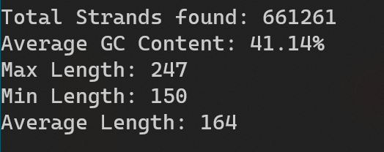
Results
Total Strands: 661261
GC Content: 41%
Max Length: 247
Min Length: 150
Avg Length: 164
Cycles: 20
Notes:
Seeding of Random was done to obtain a consistent result.
Strand Count does not include empty “falloff” Strands

Slide 18
Questions?

Slide 19
References
Animations: https://www.bio-rad.com/webroot/web/movies/lse/global/english/what-is-polymerase-chain-reaction/tutorial.html
Data about Genome: https://www.ncbi.nlm.nih.gov/nuccore/NC_045512

